Slide 1
Minnesota Laboratory Professionals’ Workforce Summit
October 13, 2017
CentraCare Health – Windfeldt Room

Slide 2
Welcome and introductions

Slide 3

AGENDA
Introductions
Federal Update
Workforce Planning Initiatives
Career Pathways – Review & Discussion
Notes:
Agenda Items:
Workforce Discussion
- CNA/CMAs
CentraCare Clinic
Sartell High School
- CHWs
- Community Paramedics
- Repiratory Therapists
- Certified Translators
Presentation of Results of School Surveys - Vickie Ruegemer CCH
Discussion of Target Areas
- Geographic Target Region
Legislative Issues - Discussion

Slide 4
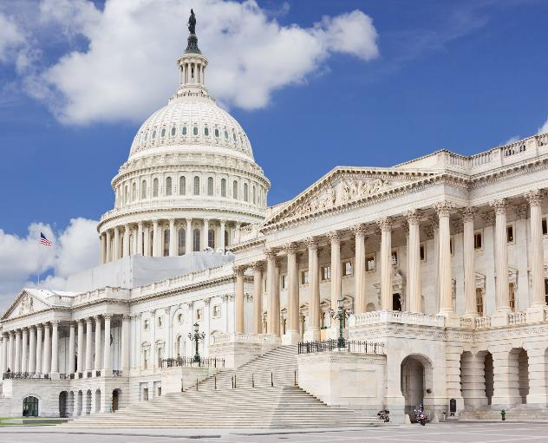
Federal Update

Slide 5
ACA Status

Slide 6

Enrollment
ambulance

Slide 7

Some rough numbers
Taken from a variety of sources
Much lower than projections made in 2010
45 million
30 million
16 million
10 million
11 million

Slide 8
Some rough numbers
45 million – Estimated number of uninsured prior to enactment of the Affordable Care Act
45 million
30 million
16 million
10 million
11 million

Slide 9
Some rough numbers
45 million
30 million – CBO estimate of uninsured remaining in 2026
45 million
30 million
16 million
10 million
11 million

Slide 10
Some rough numbers
45 million
30 million
16 million – Reduction in the number of uninsured individuals
45 million
30 million
16 million
10 million
11 million

Slide 11
Some rough numbers
45 million
30 million
16 million
10 million – Estimate of enrollees in ACA Exchanges going forward
45 million
30 million
16 million
10 million
11 million

Slide 12
Some rough numbers
45 million
30 million
16 million
10 million
11 million – Number new Medicaid enrollees
45 million
30 million
16 million
10 million
11 million

Slide 14
ACA Status

Slide 15
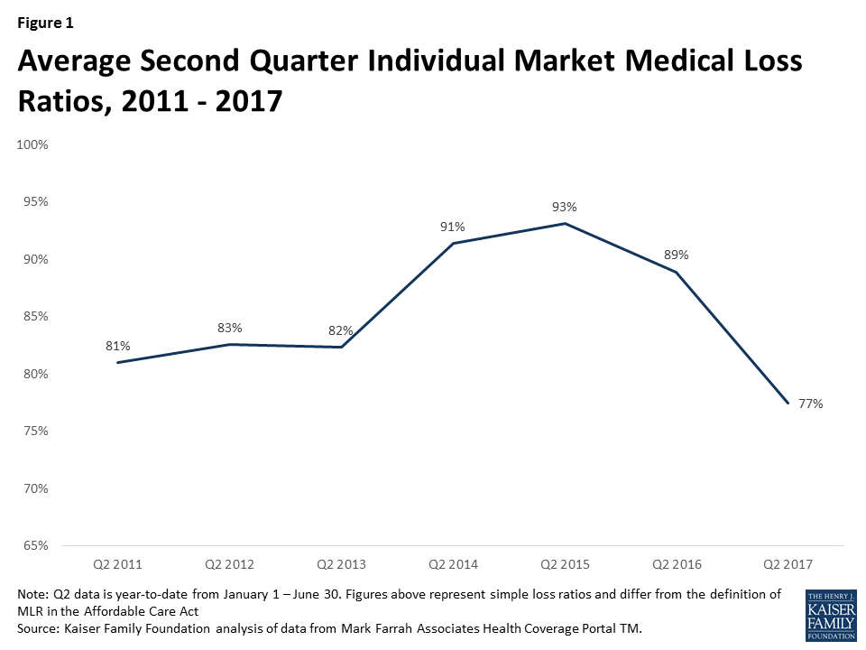
Insurance Plans Doing Better

Slide 16
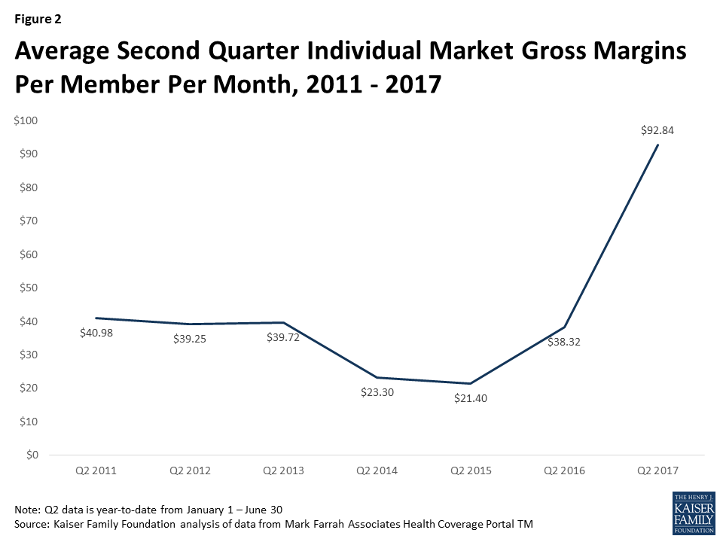
Insurance Plans Doing Better

Slide 17
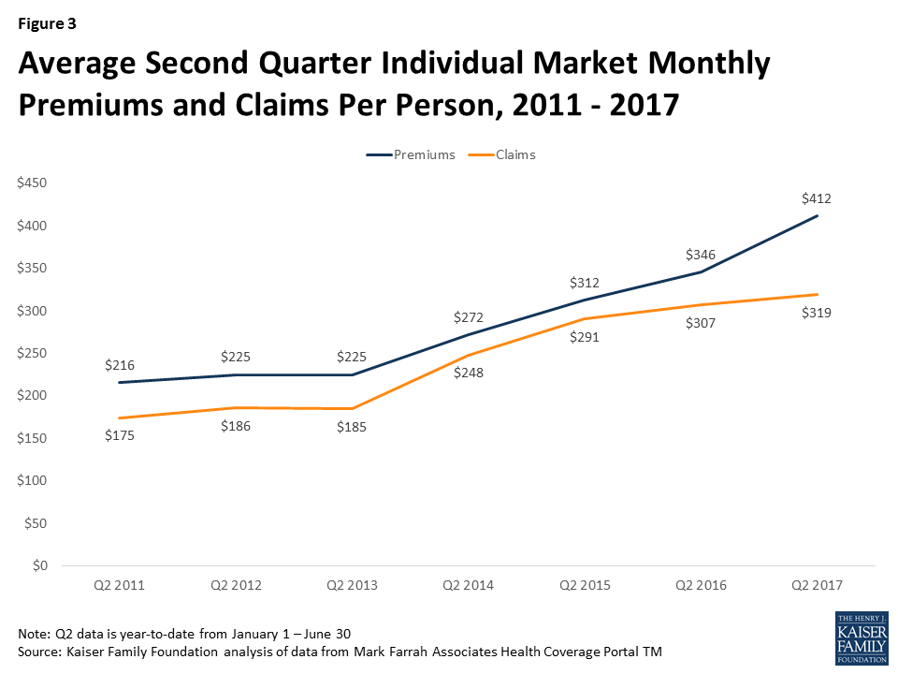
Insurance Plans Doing Better

Slide 18
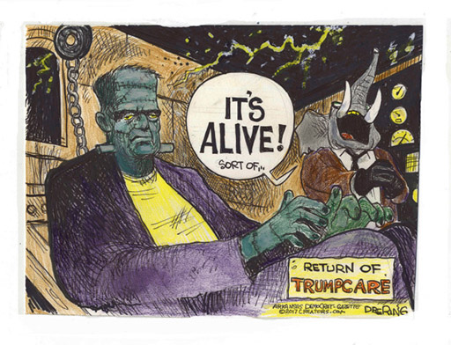
“Repeal & Replace”

Slide 19
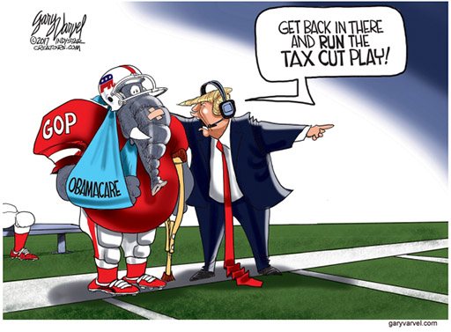
“Repeal & Replace”

Slide 21
What could be done to the ACA administratively?
Eliminate or weaken the individual mandate (Likely)
  Create additional exemptions to the individual mandate
  Avoid IRS enforcement of penalties
Reduce employer burdens by failing to enforce employer responsibility mandate
Reduce burdens on health plans
  Reduce/eliminate special enrollment periods
  Delay enforcement of quality and cost reporting – reducing transparency
  Revise medical loss ratio to allow more plan flexibility for increased administrative and marketing functions.
Rulemaking Authority or Use of Executive Orders

Slide 22
What could be done to the ACA administratively?
Increase the flexibility of plan benefits
  Extend the availability of non-ACA-compliant plans (subject to state law)
  Stop Justice Department suits defending Obama administration actions requiring all plans to offer all FDA approved contraception
  Relax standards for health plan network adequacy requirements
  Relax various consumer/employee non-discrimination protections for both insurance plans and wellness activities
Rulemaking Authority or Use of Executive Orders

Slide 23
What could be done to the ACA administratively?
Take steps to weaken the marketplaces
  Limit risk corridor payments to the amounts Congress appropriates each year and continue to fight lawsuits by insurers to obtain these payments.
  Increase administrative barriers to enrolling in Marketplace plans, for example by:
    Requiring additional verification of individuals seeking eligibility for premium and cost-sharing subsidies
    Reconciling advance payments of premium assistance with income information.
  Disable or defund the CMS Center for Consumer Information and Insurance Oversight
    Stopping fund for outreach and enrollment assistance
    Eliminating staff.
Rulemaking Authority or Use of Executive Orders

Slide 24
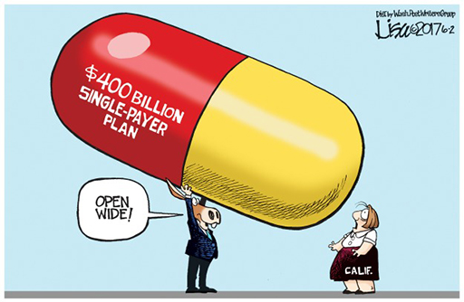
And then there is single payer…

Slide 25
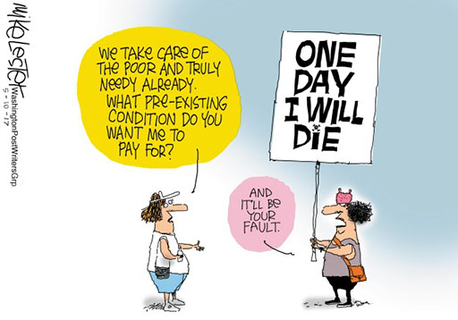
And then there is single payer…

Slide 26
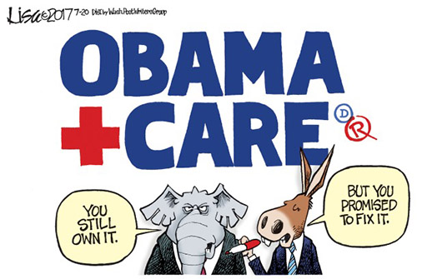
The central issue IS politics…

Slide 27
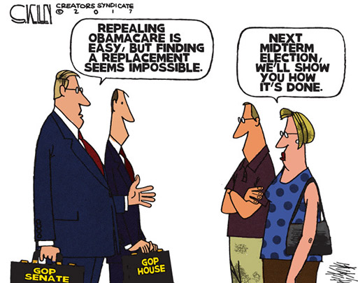
…and, re-election

Slide 28
Impact on the community
Continued uncertainty impacting economic growth
Though slower, health care COSTS will continue to grow
Health care insurance costs will continue to grow faster for companies that cannot self-insure – especially smaller employers
Fewer options for coverage in the fully-insured market
Emergence of "narrow network" insurance products that exchange access and convenience for lower costs
Impact of government deficit spending on economy
Dysfunctional government resulting from current political environment

Slide 29
Workforce initiatives

Slide 30
A changing landscape…

Slide 31
A changing landscape…

Slide 33

Workforce Development
Consortium

Slide 34
Our goal:
Create an adequate supply of health care professionals to meet the need of our target region

Slide 35
Our Strategy – Working together:
Assess and predict the need for various health care workers in the upcoming years
Determine the current capacity of education system to train those workers
Do a gap analysis
Work collaboratively to:
  Right size education programs
  Recruit workers to health care professions

Slide 36
Major Findings… thus far
There are not enough young people entering the health care worker “pipeline”
Outside of the (St. Cloud) Metro Area, educational programs are below capacity
The “pipeline” is not big enough – barriers include:
  Lack of instructors
  Shortage of clinical training slots

Slide 37
Career pathways
Review & Discussion

Slide 42
Focus Areas – Follow-up Discussion
CNAs and CMAs
Community Health Workers
Community Paramedics
Respiratory Therapists

Slide 45
Questions and discussion

