Slide 1
Unit 11: Clinical judgment
Written by Kathleen McCullough-Zander, MA, RN, CTN

Slide 2
Clinical judgment
“The ways that nurses understand a patient’s problems or concerns and respond to them appropriately.”

Slide 3
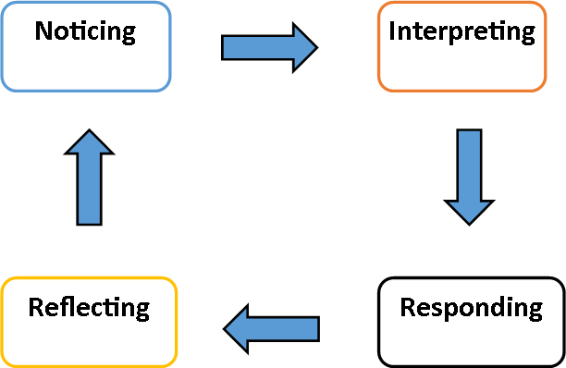
Tanner’s model of clinical judgment

Slide 4
Four phases of clinical judgment
Noticing – identifying the situation
Interpreting – understanding the situation
Responding – plan of action
Reflecting – reviewing the process
Tanner, C.A. (2006). Thinking like a nurse: A research-based model of clinical judgment in nursing. Journal of Nursing Education, 45 (6), 204-211.

Slide 5
Noticing influenced by:
Context (setting)
Nurse’s experience
Nurse’s knowledge base
Nurse’s ethical perspective
Nurse’s relationship with the patient

Slide 6
Interpreting:
3 main reasoning patterns used by nurses; usually a combination of patterns
Analytic – break down the situation into parts and examine the parts (critical thinking)
Intuitive – rapid pattern recognition
Narrative – knowing the patient’s wants & needs

Slide 7
Responding:
Developing a plan of action
Doing it

Slide 8
Reflecting:
This is where clinical learning occurs & clinical wisdom develops
Analytic - breakdown a situation to identify where things went wrong
Narrative – telling the story of the situation to other nurses and gaining input

Slide 9
Lasater’s Clinical Judgment Rubric
View clinical lab simulation

