Slide 1

N95 Mask Fit Testing
September 9, 2020

Slide 2

Land Acknowledgment
We are present today on Indigenous lands and recognize and honor the Anishinaabe and Dakota nations.
Notes:
As we gather to learn, network, and share best practices to address the needs of our students and communities we want to take a moment to recognize the land which we occupy. In Minnesota, there are seven Anishinaabe (Chippewa, Ojibwe) reservations and four Dakota communities.
Today we gather on native land and to recognize the land is an expression of gratitude and appreciation to those whose territory we reside on, and a way of honoring the Indigenous people who have been living and working on the land from time immemorial.
It is important to understand the long-standing history that has brought us to reside on the land, and to seek to understand our place within that history. We encourage all participants to build mindfulness of our equity and inclusion as we spend our time together.

Slide 3

Agenda
Introductions
Review the OSHA standards
Respirators, Medical questionnaire, Templates
Seal Testing
Qualitative Fit Testing Procedure
Resources for campuses to purchase fit testing kits
Resources for further training of fit testers
Q&A Session

Slide 4
Introductions

Slide 5
Introductions
Jennifer Eccles, PhD RN, System Director for Nursing Initiatives, The Minnesota State HealthForce Center of Excellence
Chandler Holland, Director of Environmental Health and Safety, Minnesota State University - Mankato
Sandy George, RN, Inver Hills Community College
Ken Auer, Interim Director of Public Safety, Minnesota State

Slide 6
OSHA Standards
1910.134 App A Fit Testing Procedures (Mandatory)
OSHA-Accepted Fit Testing Procedures
Chandler Holland

Slide 7
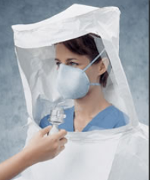
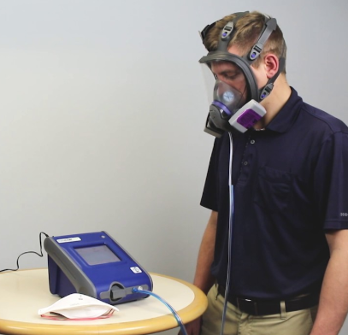
Fit Testing
Who can perform
Qualitative vs. Quantitative Fit Test
(Isoamyl Acetate, Saccharin, Bitrex & Irritant Smoke)
Choosing respirator model and size (options limited due to COVID-19)
Donning instructions (facial hair, position nose/chin, straps)
Seal check

Slide 8
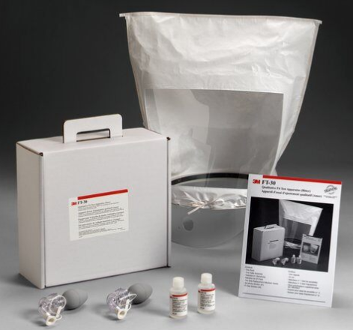
Fit Testing....cont.
Equipment (Bitrex)
Nebulizers
Threshold check solution
Bitrex Solution
Hood/enclosure (~12" diameter x ~14" tall and clear of respirator)
Fit test record sheet
Rainbow passage

Slide 9
Respirators,
Medical Questionnaire, & Templates
Chandler Holland

Slide 10
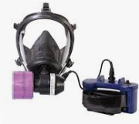
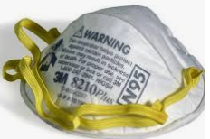
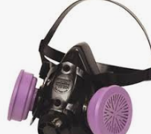
Respirators 101
Hazard assessment....can we avoid a respirator?
Change in product or process
Engineering controls
Respiratory Protection Program (written program) vs Voluntary Use Program
All respirators are not created equal
This is my respirator. There are many like it, but this one is mine. My respirator is my best friend. It is my life. I must master it as I must master my life.....

Slide 11
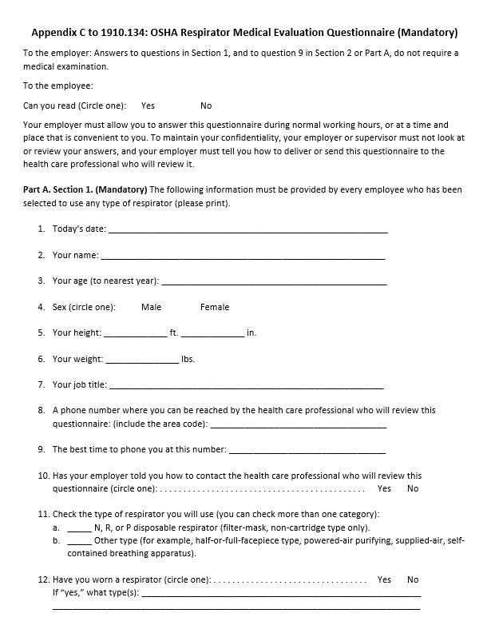
Forms
Medical Questionnaire – Appendix C

Slide 12
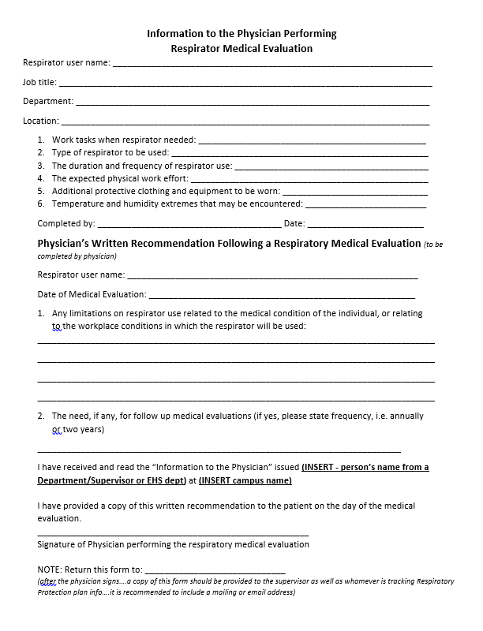
Forms...cont
Physician Authorization

Slide 13
Forms...cont
Annual Respirator Questionnaire

Slide 14
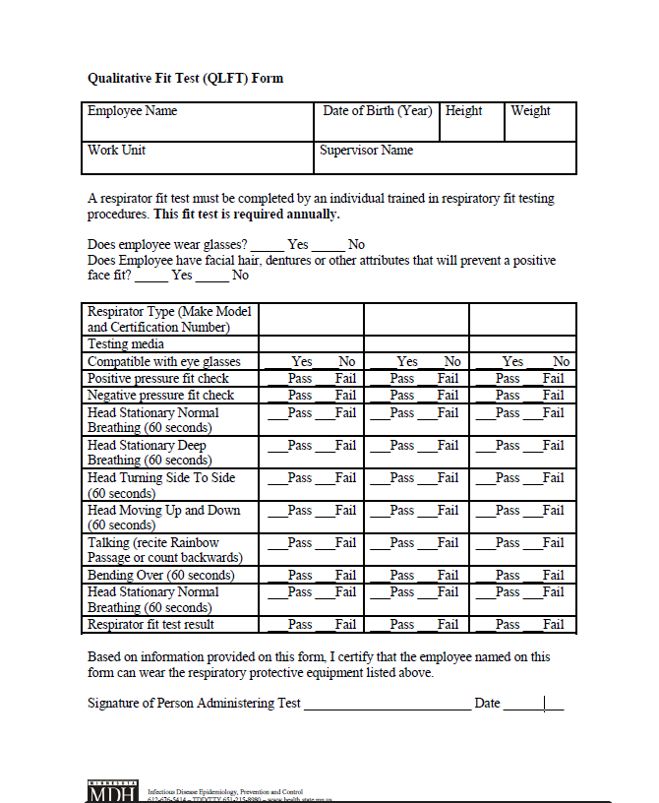
Forms...cont
Fit Test Form

Slide 15
Seal Testing
Sandy George

Slide 16
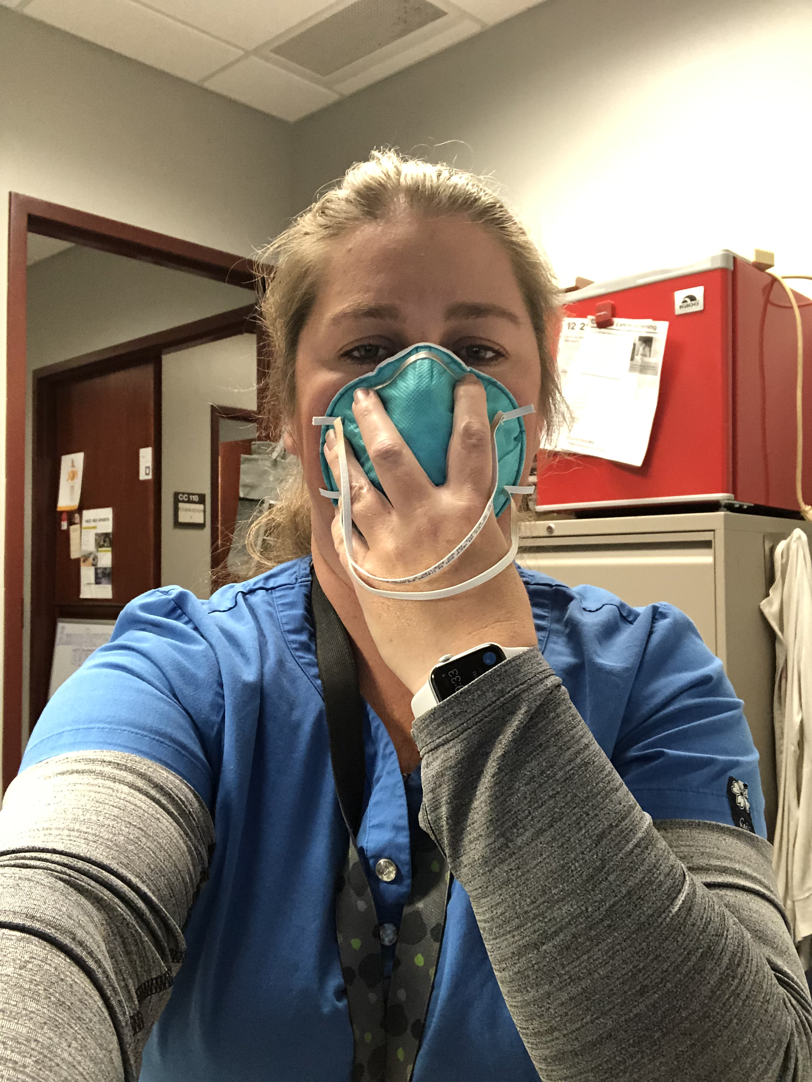

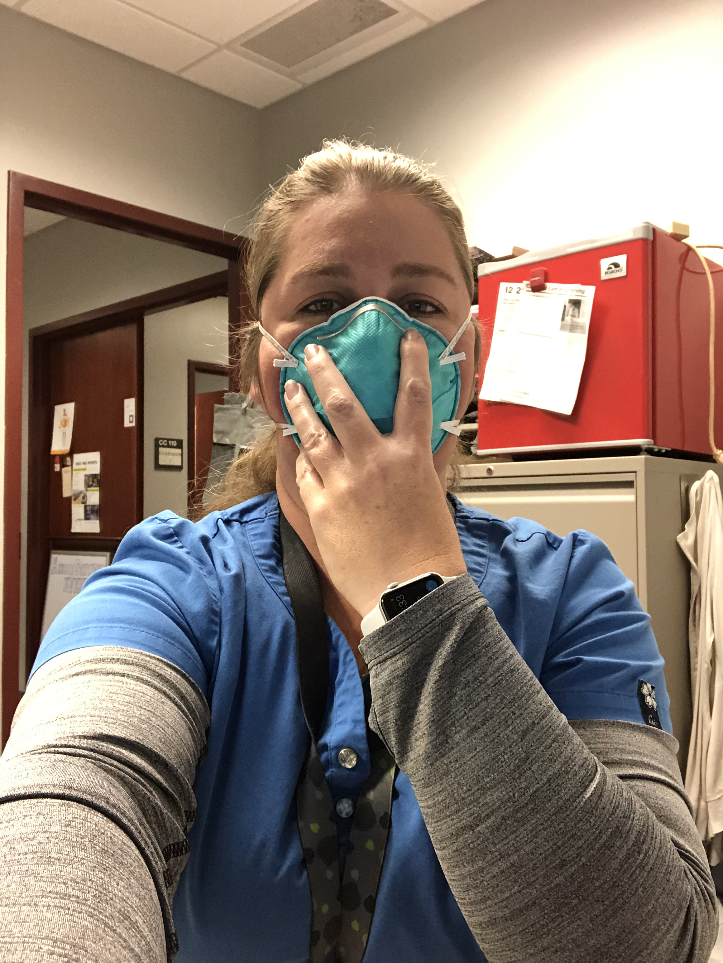
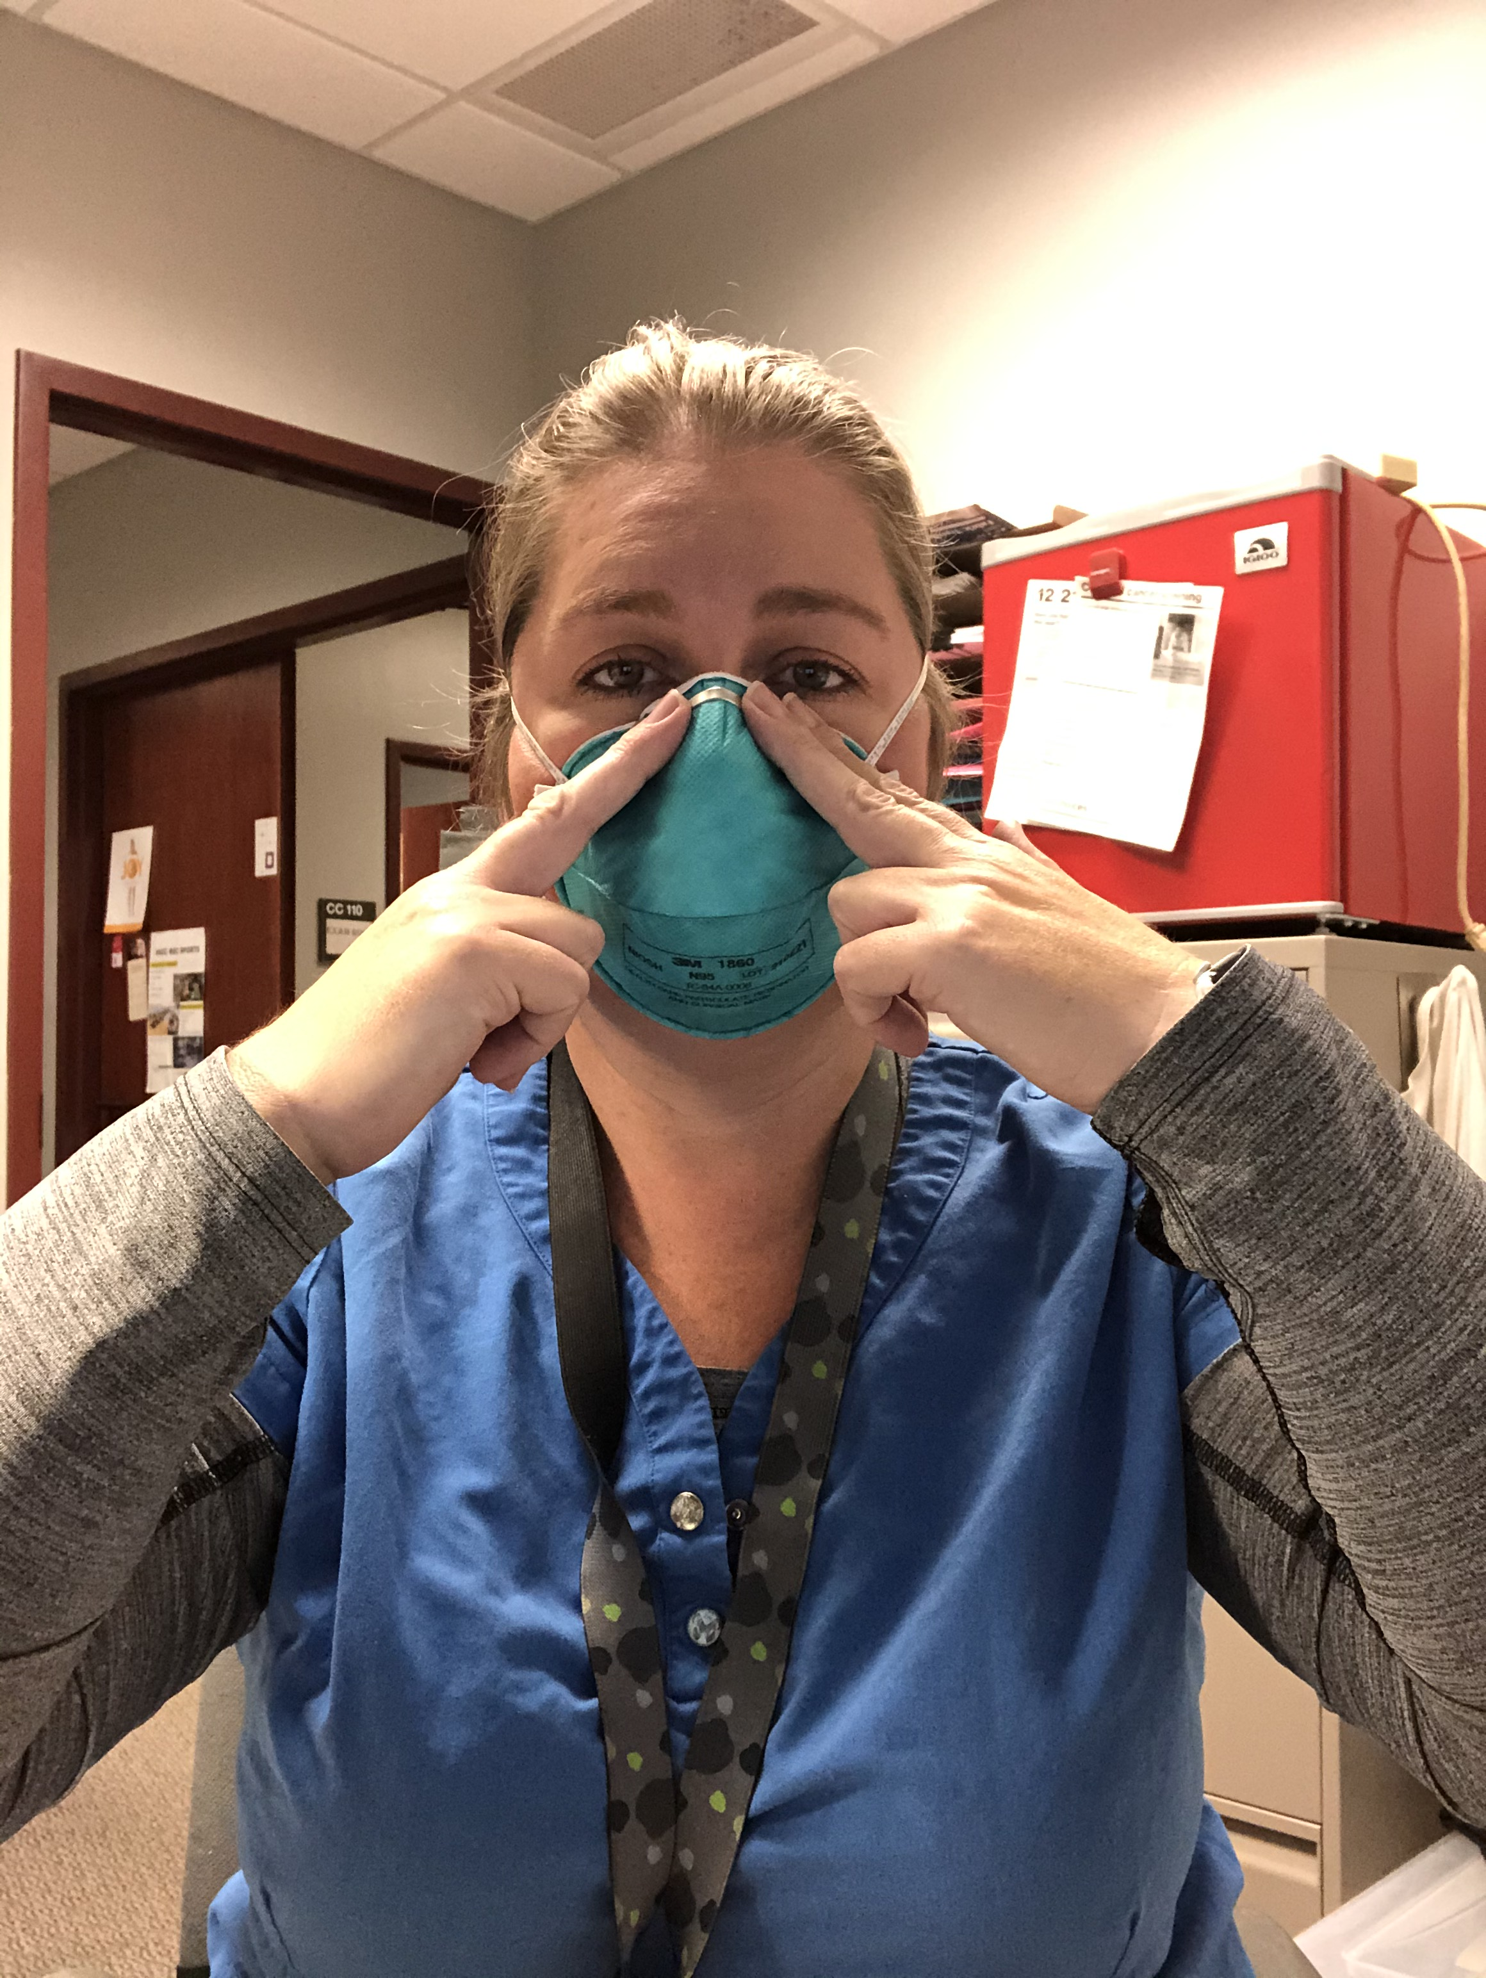
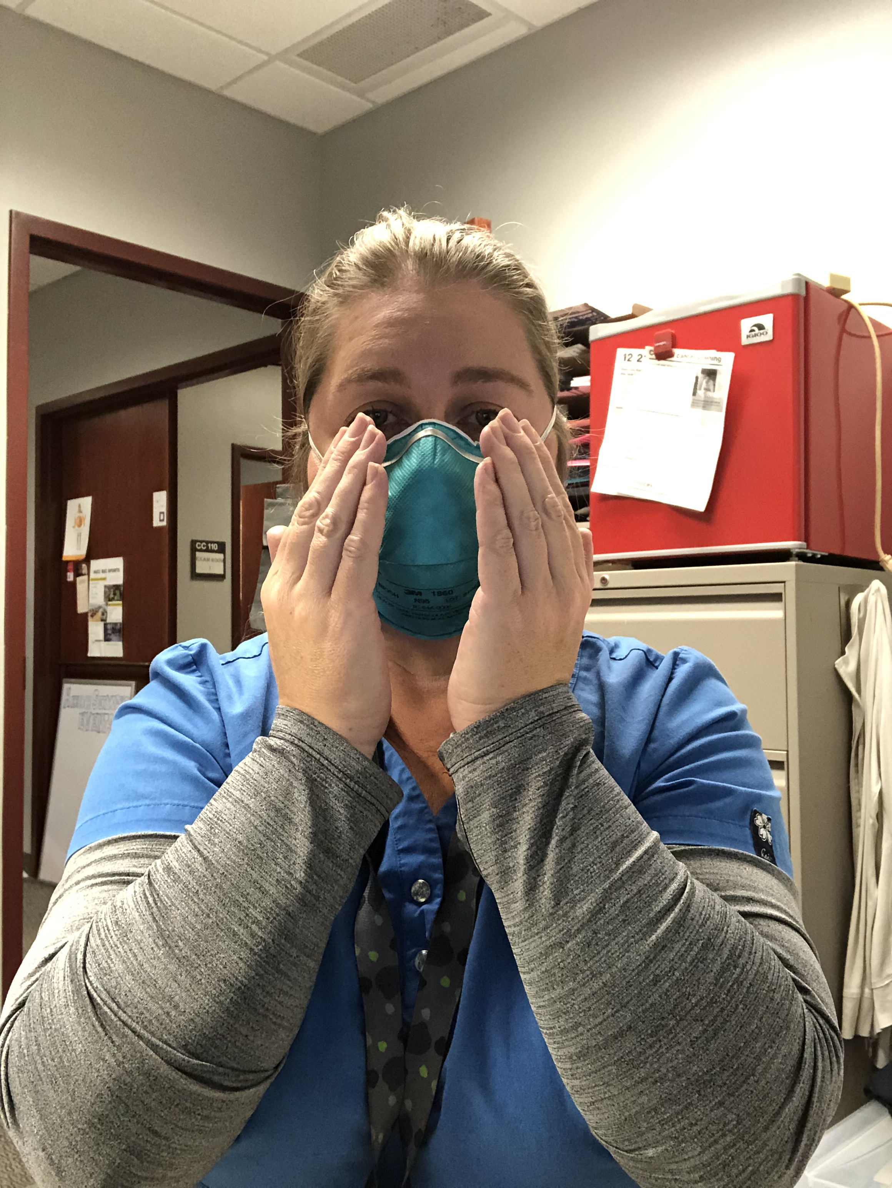
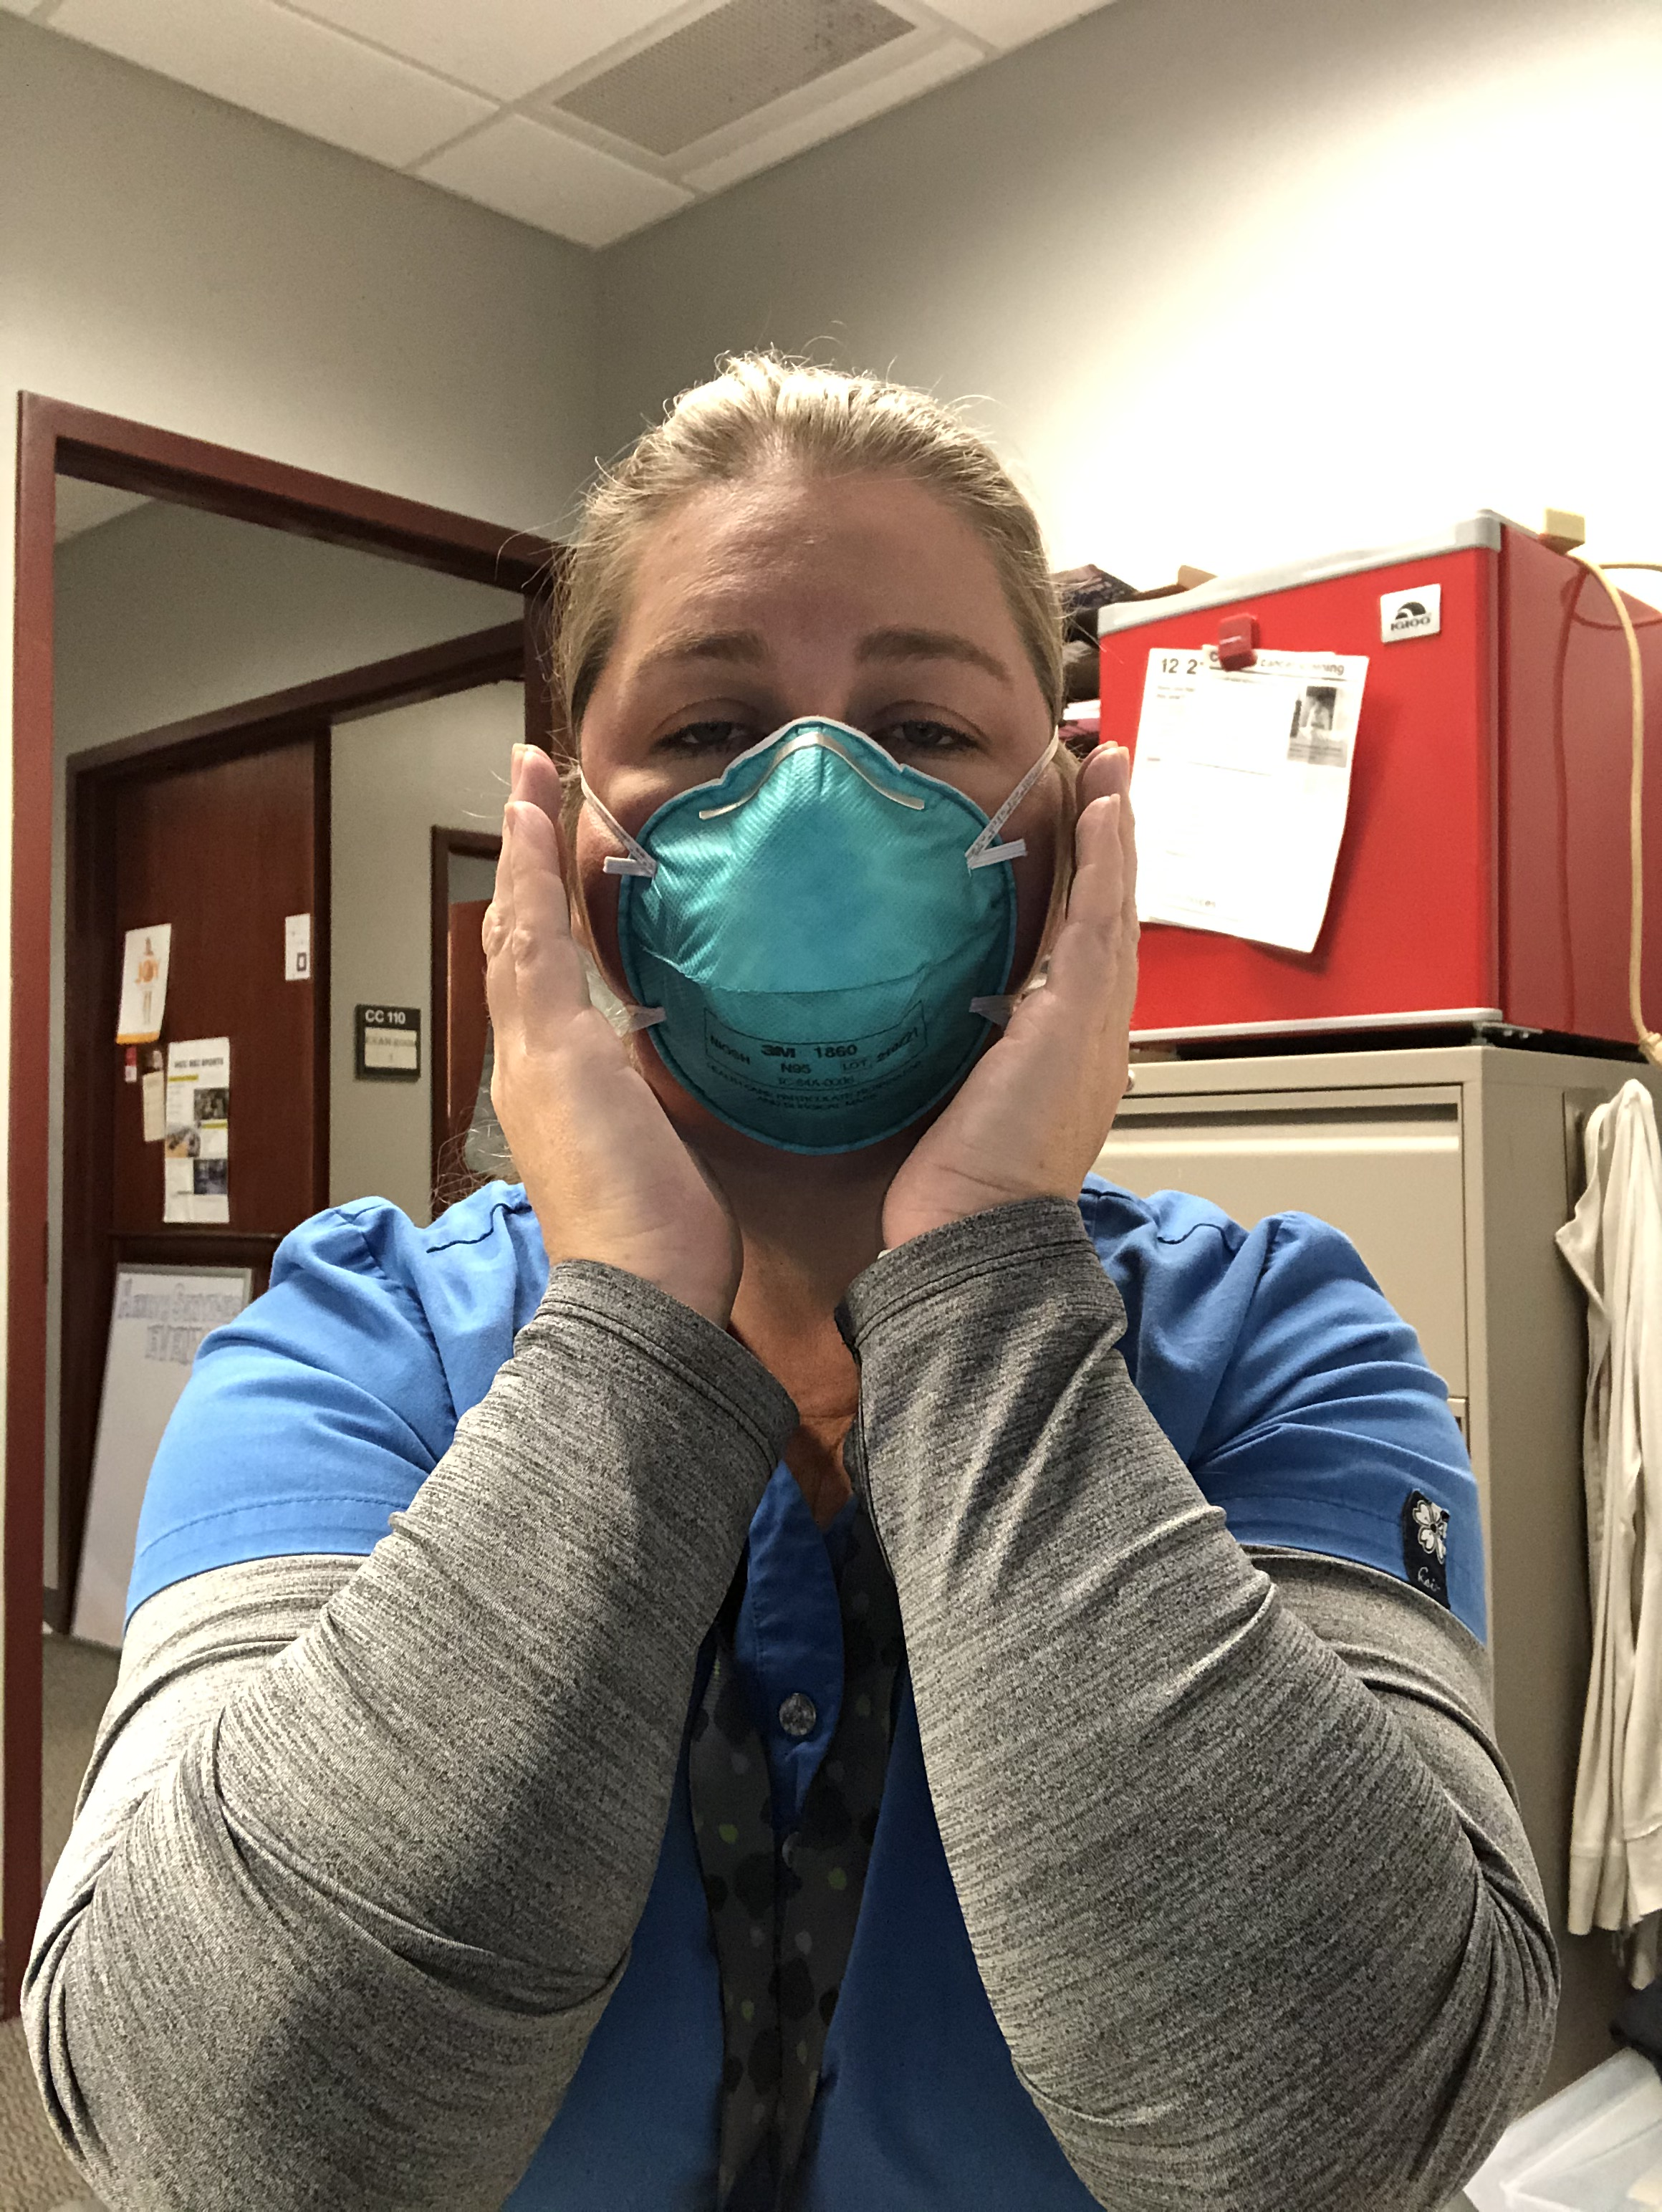
Key Points
Only proper fit tested masks should be worn
Check your mask seal every time you put the mask on
Follow guidelines for your specific mask on placement
Once properly placed put two hands over your mask gently and blow out
If you feel air escaping you do not have an adequate seal
  Recheck proper placement
  Common leaks occur around nose piece due to pinching
  Tighter seals may be achieved by adjusting the lower strap higher on the back of the head
https://www.cdc.gov/niosh/docs/2018-130/pdfs/2018-130.pdf

Slide 17
Qualitative Fit Testing Procedure by 3M
Jennifer Eccles

Slide 18
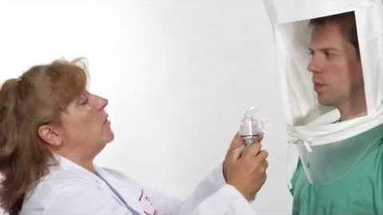
N95 Fit Test Instructions 3M Health Care Respirator

Slide 19
Fit Testing Kit Resources
Ken Auer

Slide 20
List of Vendors
Grainger: https://www.grainger.com/category/safety/respiratory-protection/respiratory-equipment-fit-testing-storage-accessories/respirator-fit-testing
3M: https://www.3m.com/3M/en_US/company-us/all-3m-products/~/All-3M-Products/Personal-Protective-Equipment/?N=5002385+8711017+8717419+8740261+3294857497&rt=r3

Slide 21
Fit Testing Training Resources
Jennifer Eccles

Slide 22
Fit Testing Training Resources
Certification in Fit Testing is NOT required to perform Fit Testing. BUT you really need to do this properly for the health and safety of your employees and students.
OSHAcademy (free): https://www.oshatrain.org/courses/mods/756m1.html
MyMedCerts ($14.99): https://www.mymedcerts.com/resp.cfm
XO Safety Academy ($49.00): https://www.xosafety.academy/courses/performing-respirator-fit-tests

Slide 23
Questions & Answers
Website: https://www.healthforceminnesota.org/COVID-19%20Resources/college-educators-covid-19-resources.html

